Slide 1



Workshop Day 2: SIMROUTE® Marine environmental module: methodology and calculation of Ship Emissions
Exercise
Chalmers University of Technology
April 6th, 2022

Slide 2
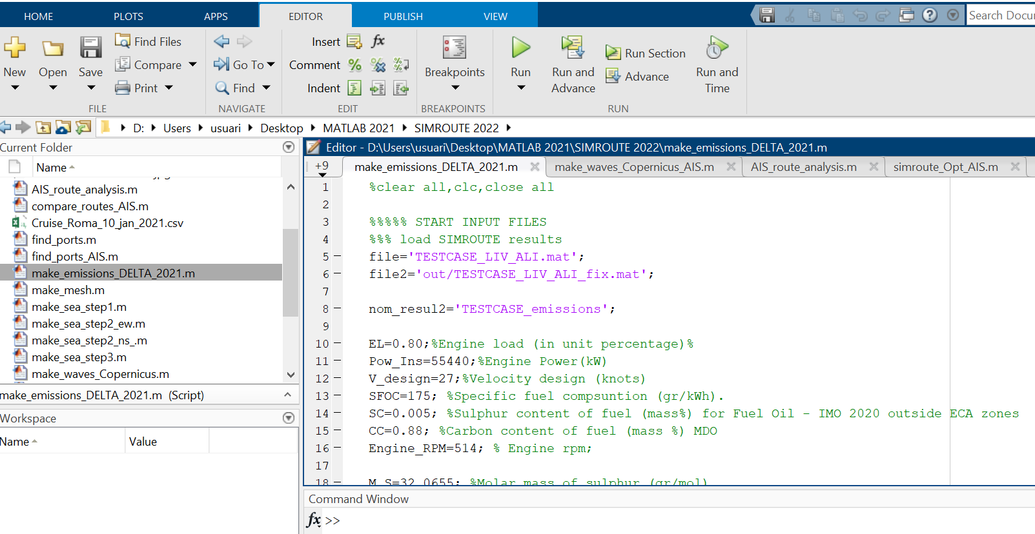
EMISSIONS MODULE

Slide 3
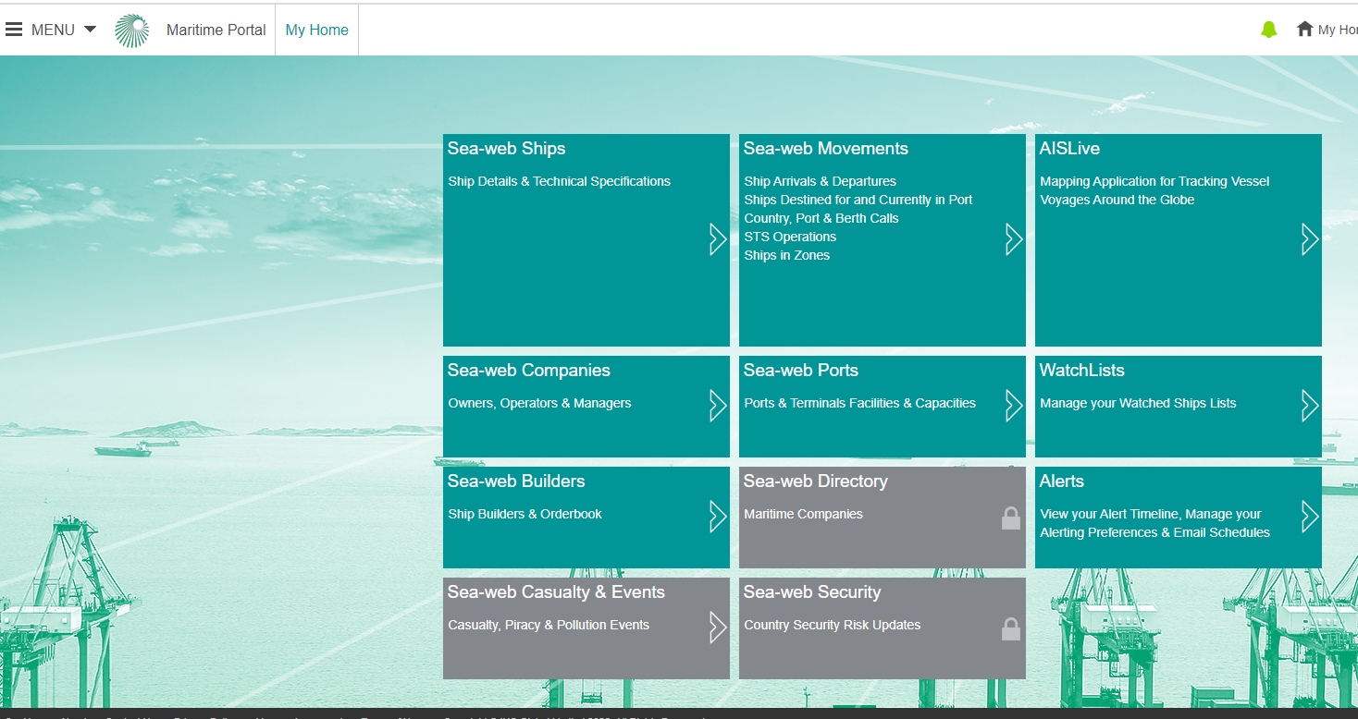
https://maritime.ihs.com

Slide 4
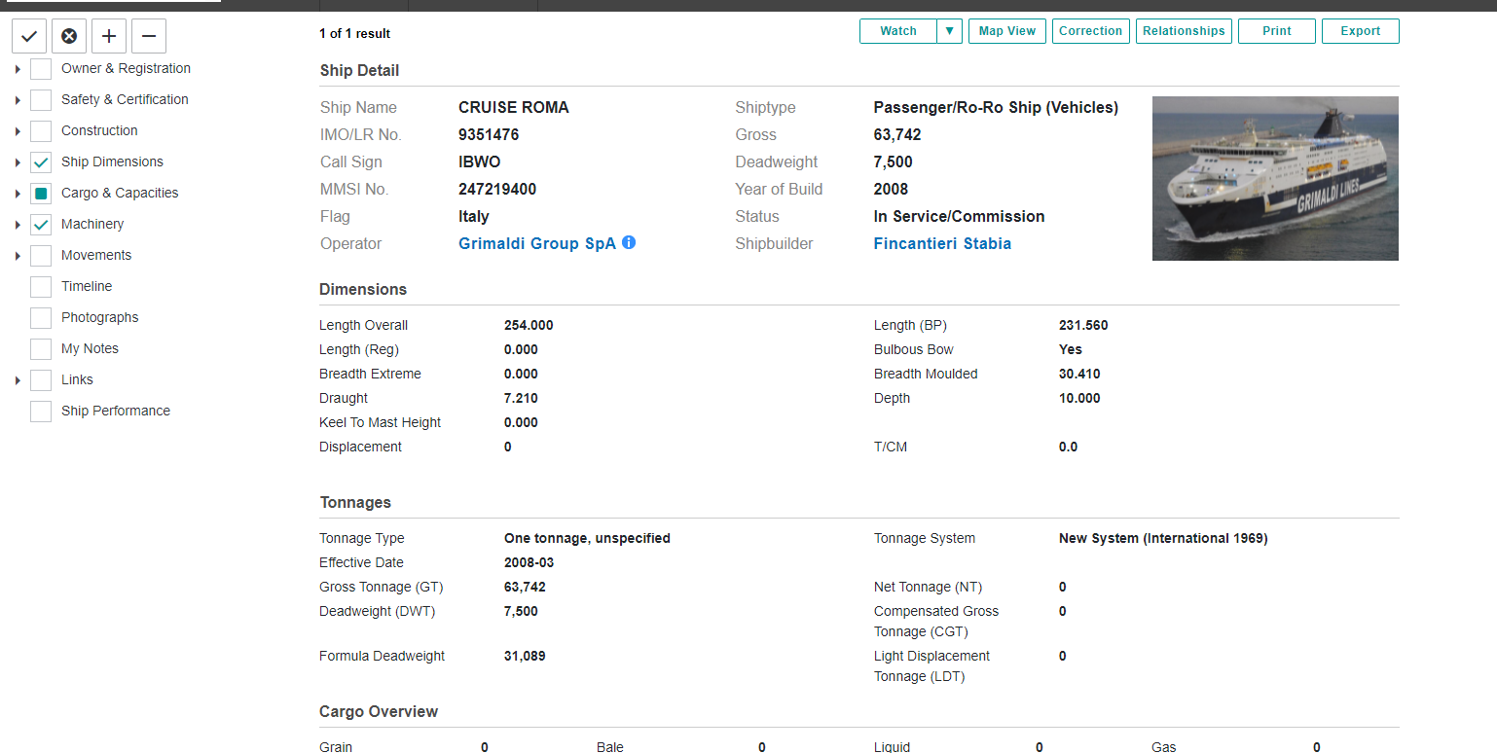
https://maritime.ihs.com

Slide 5
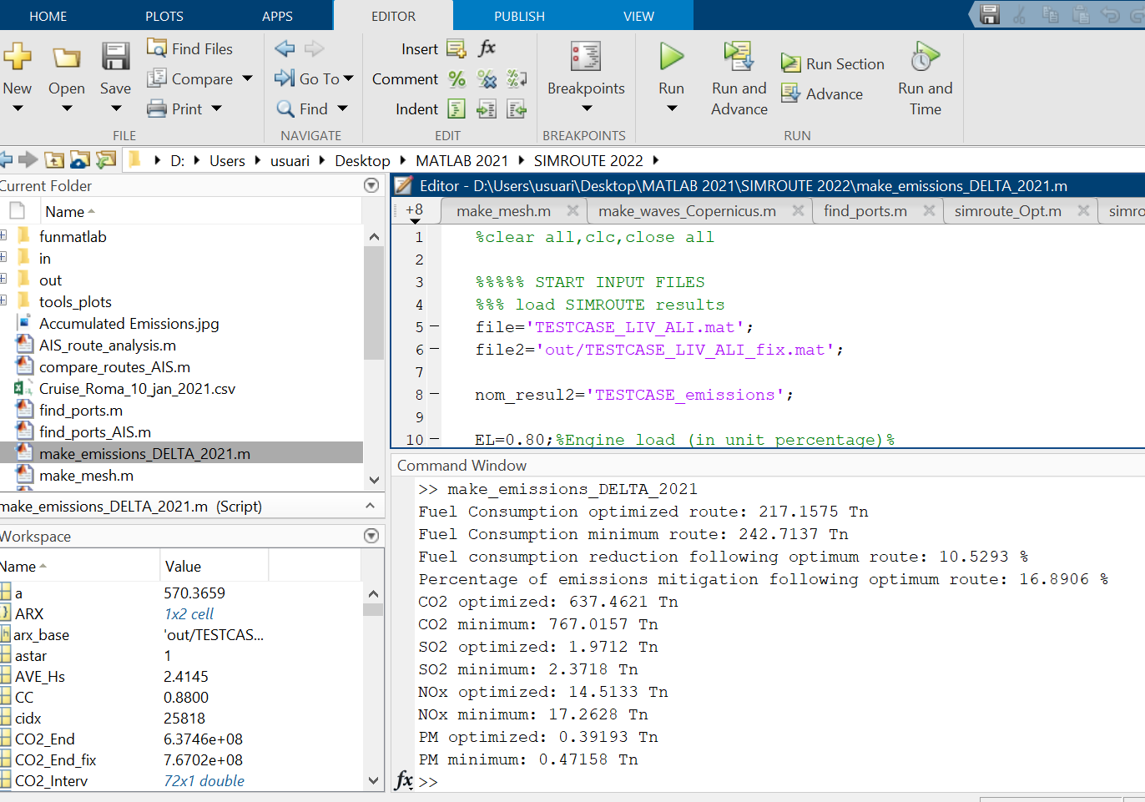
EMISSIONS MODULE

Slide 6
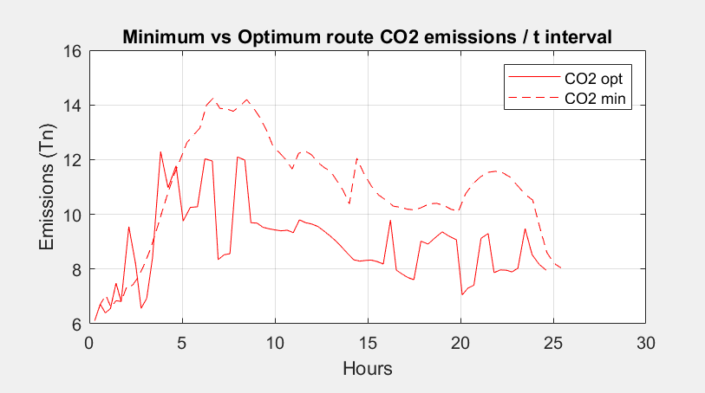
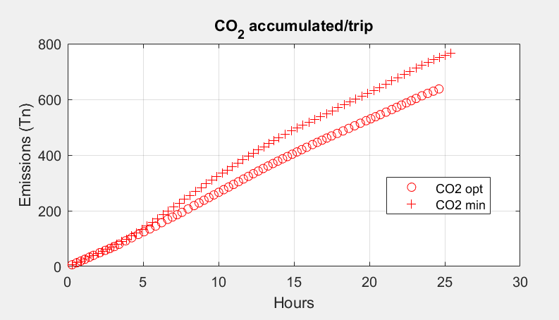
EMISSIONS MODULE

